Slide 1
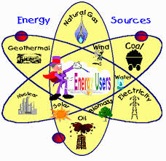
Earth’s Resources
6th grade science

Slide 2
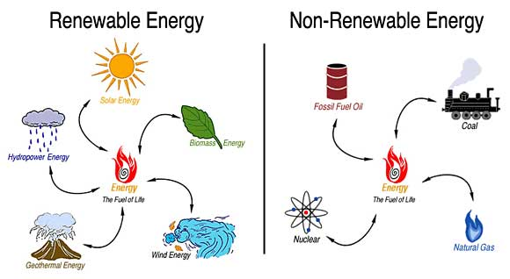
Types of energy resources
nonrenewable resources
renewable resources

Slide 3
nonrenewable resources
fossil fuels
coal
oil
natural gas

Slide 4
nonrenewable resources

Slide 5
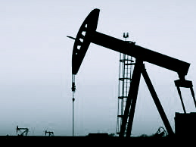
nonrenewable resources
Uses of fossil fuels
Coal | To generate electricity
Oil | To produce gasoline and other fuels As lubricants To make plastics, home shingles, and other products
Natural gas | To heat buildings As a source of sulfur

Slide 6
nonrenewable resources
Can you think of some advantages and disadvantages of using fossil fuels to produce energy? Choose one and write about it in your journal. Write as many sentences as it takes for you to convince me that your opinion is correct. Happy Writing!

Slide 7
renewable resources
solar energy
solar panels are used to collect energy from the sun and transform it into electricity
invented to generate electricity for satellites
dependent on sunlight

Slide 8
renewable resources
wind energy
uses windmills to generate electricity
wind farms
depends on wind

Slide 9
renewable resources
hydroelectric energy
water energy
dams
can change landscape and habitats

Slide 10
renewable resources
biomass energy
burning wood, alcohol, and garbage
air pollution
producing liquid biomass fuels takes more energy to produce than it produces

Slide 11
renewable resources
geothermal energy
uses hot magma or hot, dry rocks inside Earth
wells harvest steam from large reservoirs of groundwater

