Slide 1
Water Erosion and Deposition
6th grade science

Slide 2
Surface Water
runoff
water erosion
river system development
stages of stream development
too much water
deposition by surface water

Slide 3
runoff
water that doesn’t soak in the ground or evaporate but instead flows across Earth’s surface
affected by:
amount of rain
length of time it rains
landscape
gravity

Slide 4
water erosion
rill erosion- small stream (rill channel) forms during a heavy rain
gully erosion- rill channel becomes wider and deeper

Slide 5
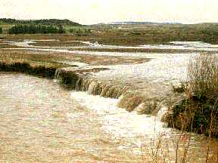
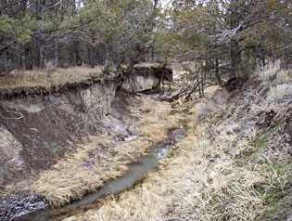
water erosion
sheet erosion- runoff that flows as thin, broad sheets
stream erosion- water in stream flows and picks up sediment, wearing away rock and soil

Slide 6
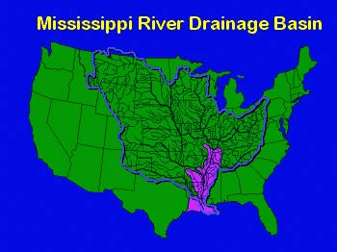
river system development
Streams are part of river systems.
water comes from rills, gullies, and streams
drainage basin- area of land from which a stream or river collects runoff
like a bathtub- water flows toward the drain (drainage basin)

Slide 7
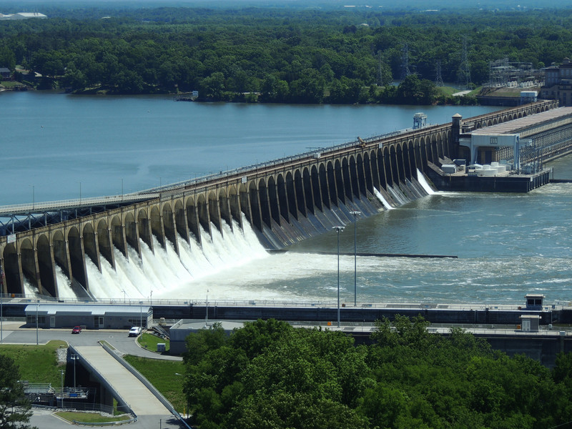
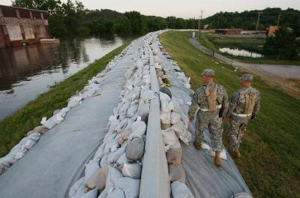
too much water
floods
Dams and levees are built to try to prevent flooding

Slide 8
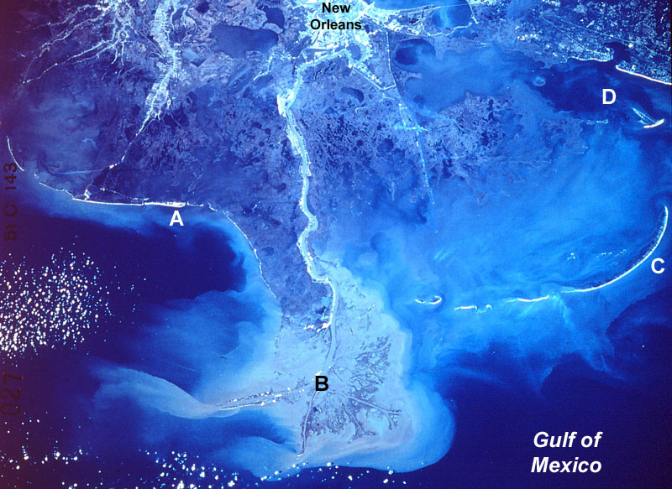
deposition by surface water
As water flows in streams, the sediment get deposited along the way.
delta- place where sediment is deposited as water empties into a lake or ocean

Slide 9
Groundwater
groundwater systems
water table
the work of groundwater

Slide 10
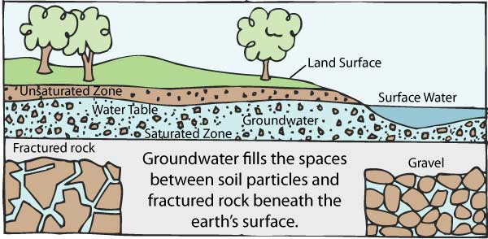
ground water systems
permeable- soil and rock have connected pores
impermeable- few pore spaces, no water can pass through it
water that soaks into ground and collects in pores and empty spaces

Slide 11
ground water system
permeable
impermeable

Slide 12
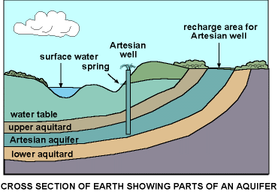
water table
aquifer- a layer of permeable rock that allows water to move freely
water table- upper surface of the zone of saturation (where all of the pores in the rock and soil are filled with water).

Slide 13
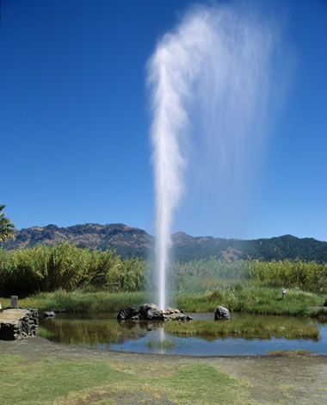
water table
geysers- a hot spring that erupts periodically, shooting water and steam into the air
wells- collection of water that extends into the zone of saturation past the water table
springs- place where the water table is so close to the Earth’s surface that water flows out

Slide 14
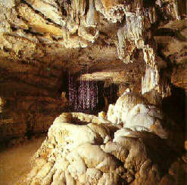
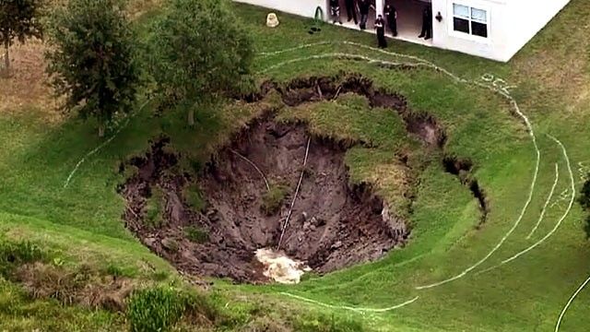
the work of ground water
cave formation- water dissolves rock to form caves and deposits material
sinkholes- underground rock is dissolved near the surface

